Slide 1

University Workshop Series
Power Platform and AI Builder
Glendon Thaiw, Technology Specialist (Azure & Bizapps)
Notes:
Hey everyone - I'm Glendon, a Technical Specialist with the Microsoft Business Applications team in Singapore.
Thank you so much for taking the time for today’s session – we really appreciate the opportunity.
In the next 20 mins or so, I'd be walking you through the Dynamics 365 Omnichannel for Customer Service experience.

Slide 2
Agenda
TRANSFORMATION ENABLERS
Introduction to Microsoft Power Platform and AI Builder
Building Models with AI Builder
- Object Detection Model
- Form Processing Model
Building Canvas Apps
- Online Shopping Assistant Application
- Form Processing Automation Application
Workshop Resources
Notes:
To kickstart the session, I’d begin by briefly introducing the Dynamics 365 omnichannel for customer service suite, and discuss some interesting features that I really enjoy.
I will then go into how you can bring this into the classroom to enable our students at the Institute of Technical Education using a training manual/workshop created for this solution.
The end-to-end training manual takes the learner on a journey to provision and configure an omnichannel for customer service environment and guides them to implement modular pieces to enable different functionalities.
I will end off with a quick demonstration of the end product of what we can expect from a student from completing this training manual.

Slide 3




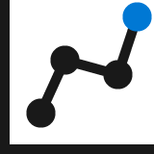




Power Platform: Everyone’s platform for transformation
Power Apps
Drive business processes
Improve engagements with customers and employees
No Code
Drag and drop experiences that are like PowerPoint
Power Automate
Power Virtual Agents
Low Code
Drag and drop plus Excel-like formulas for functionality
Automate response metrics
Analyze data from apps and bots
Power BI
Code First
Professional development and extensibility across Microsoft
AI Builder
Dataverse
Data Connectors
Management Tools
Notes:
Brings together 4 services to increase drive business value and increase ROI
to drive business processes through Power Apps, improve engagements with customers and employees through Power Virtual Agents, analyze data from apps and bots through Power BI and automate response metrics to drive business processes through power automate
All built on and supported by Dataverse which allows for external data connectors and in-built AI builder
As well as management tools to manage the current systems

Slide 4

















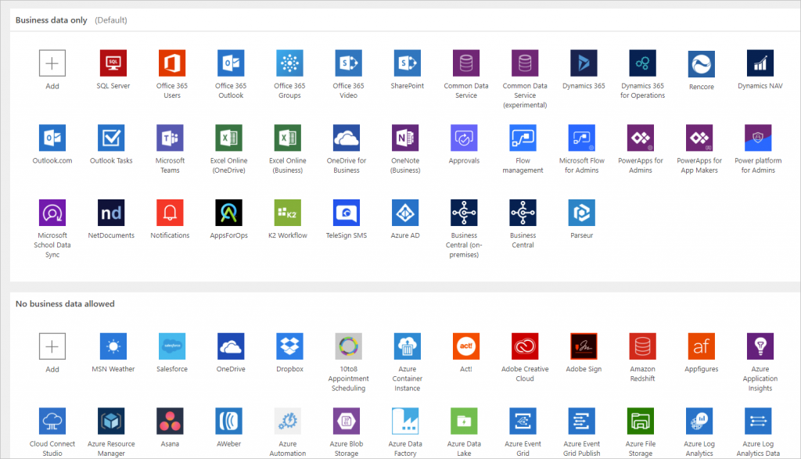
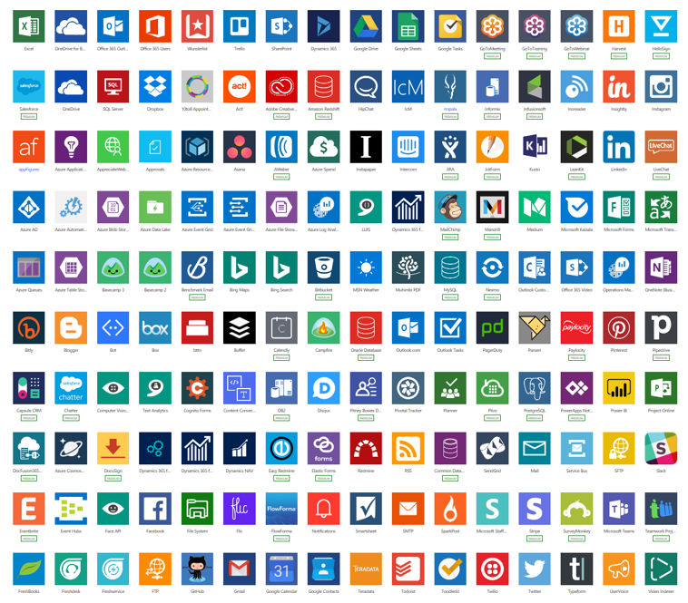
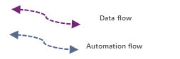
Anatomy of a Power Platform
Internal Users
Other roles + Targeted Roles
Internal Users
Targeted Users
External Users
Suppliers, Customers, Providers,
Embed Apps and Analytics
Cognitive
Experience
Measures
KPIs
Model Driven Apps
Dynamics and Non-Dynamics Apps
Canvas Apps
Portals
Power Virtual Agents
Search
Power BI
Business analytics
Power Apps
Application development
Language
Security
Knowledge
Business Unit / Sub BU / Teams
Services
Policy Management (DLP, Use, Share, …)
Hierarchical
Azure AD Based / Organization Wide
Field Level Security
May use
Common Data Service
Triggered, on-demand or recurring
AI Builder
Speech
Power Automate
Process automation
Office
Apps
Data and Integration
Use
Use
Labs
Data connectors
Vision
Business Non-Business Custom
Extend
External
Systems
Notes:
1. Experience, 2. Data & Integration & 3) External Systems

Slide 5
AI Builder Low-code AI for apps and processes
Low-code AI solutions for Power Platform leveraging the power of Azure AI.
Native integration with Common Data Service enables data from CDS, Azure Data Lakes.
Leverage predictions directly from Common Data Service across your Power Platform solutions, Dynamics 365, or Microsoft 365.
Prediction
Vision
Vision
Language
Binary classification
Predict and classify fields in CDS.
Forms processing
Extract structured data from digital paper, PDFs, and forms.
Object detection
Detect any object (via custom training) through camera or image control.
Text classification
Classify, group and categorize any text in CDS.
Notes:
AI Builder is a platform capability that allows easily adding AI to Power Automate, Power Apps and Dynamics 1st Party Apps. This enables makers to automate tasks and predict outcomes without having to involve data scientists.

Slide 6
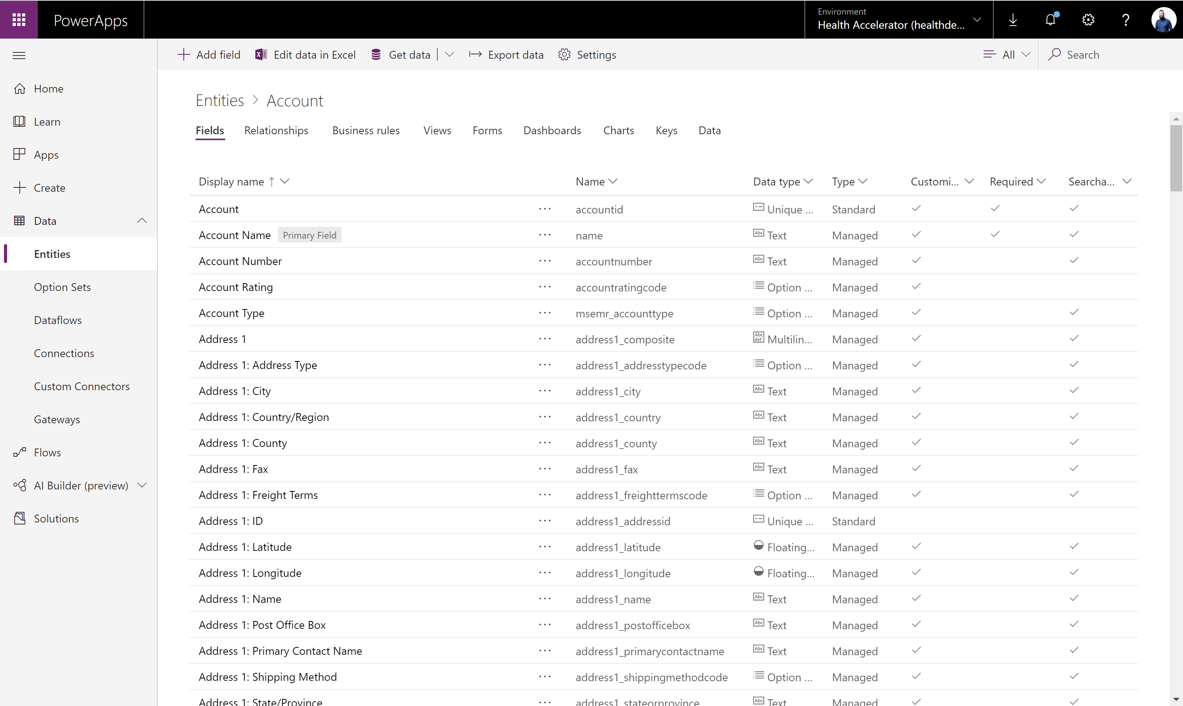

Dataverse Put all your data to work
Jumpstart apps using an extensible data model with business logic, security and integration built in.
Extend data and processes to external and anonymous users with Power Apps portals.
Support all your data: relational data, file and blob storage, logs and search indexing.
Effortless Dynamics 365, Office 365 and Azure integration as well as powerful integration capabilities.
Notes:
A mature data platform to manage data used by business applications, CDS is the platform that sits under the Dynamics 365 Sales, Service and Marketing business applications and is offered as a service to the Platform. An initial schema is defined by the Common Data Model. CDS provides built-in capabilities for business rules, workflows, calculated and rollup fields and more. CDS secures data using a configurable security model, that offers hierarchical, row level and field level security and auditing capabilities.
The Common Data Service (CDS) is a mature data platform used to securely store data for business applications built on Power Apps. CDS is an abstraction on top of underlying Azure cloud data management services to make it easier to build business applications. CDS provides not just data storage, but a way to implement business logic that enforces business rules and automation against the data. Data in CDS is organized as entities, for example account and contact would be two examples of entities. These entities can have relationships that define the business connection between the data stored in an entity. For example, John is the primary contact for Contoso would be expressed as a relationship from account to contact. The security model of CDS enables data protection down to the field level on individual records. A more thorough discussion of security will be covered in the security section of this paper.
CDS databases are created in the context of a Power Platform environment. Each environment can have only a single CDS database. CDS databases can be provisioned by you or licensed individuals in your organization to support their custom applications. A CDS databases is automatically provisioned when a Dynamics 365 Customer Engagement application is added to your tenant. The CDS language and currency settings cannot be changed afterwards, enterprise organizations that operate in multiple regions should align on a base language and base currency.

Slide 7
Dataverse Implements the Common Data Model (CDM)
CDM SCHEMA
App1
App2
AppN
Core
SALES
SERVICE
SOLUTIONS
Education
Account
CRM
Account
Competitor
Case
MARKETING
Activity
Appointment
Discount
Discount
Account
Contact
Campaign
Invoice
Contact
Contact
Currency
Contact
Opportunity
Resource
Event
Email
Lead
Order
Service
Marketing email
Goal
Marketing list
Order product
Scheduling group
Automotive
Healthcare
Letter
Phone call
Quote
Task
Marketing page
Microsoft Dataverse
Note
Social activity
…
…
…
Owner
…
Organization
Position
WEB
TALENT
TALENT
Task
Link Clicks
Department
Patient
Risk assessment
Medication
Financial Services
Web interactions
Job position
Practitioner
Encounter
Procedure
Nonprofit
Web page
Worker
Device
Episode of care
…
…
…
Care plan
ACCOUNT
ATTRIBUTES
Data source1
Data source2
Data sourceM
Description: Business that represents a customer or a potential customer
Account number
Account rating Code
Created on
Credit limit
Open deals
Open revenue
Territory id
Hotel group
Open source and shared data model that provides semantic consistency for data
Allows makers to more quickly develop applications and integrators to more easily interoperate across multiple systems
A growing set of solutions and partners that contribute to the effort by implementing CDM or extending with industry-specific domains
Notes:
An initial schema is defined by the Common Data Model on Microsoft Dataverse.
The common data model simplifies data management and app development by unifying data into a known form and applying structural and to ensure consistency across multiple apps and deployments

Slide 8


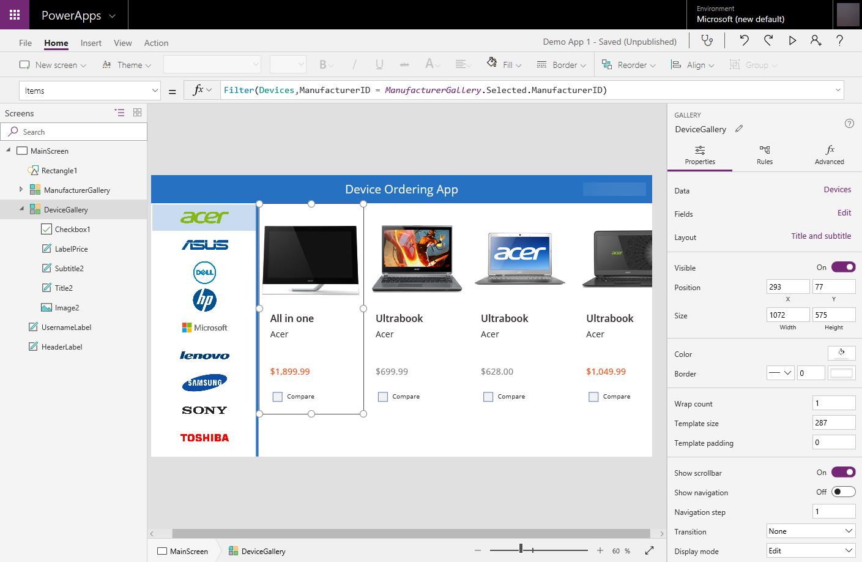
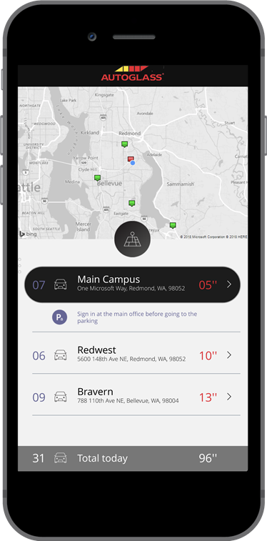

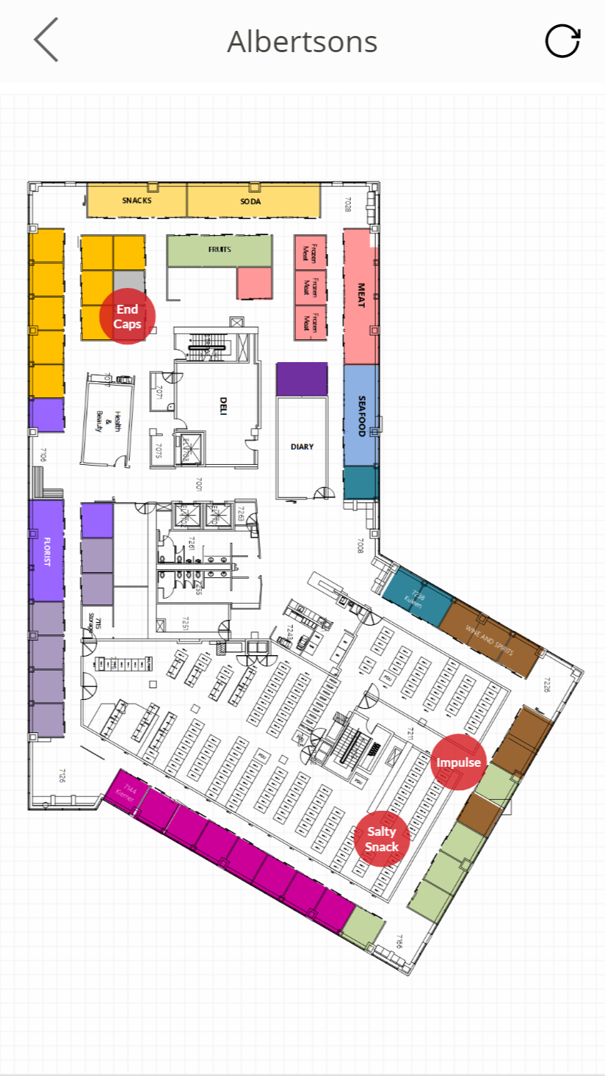
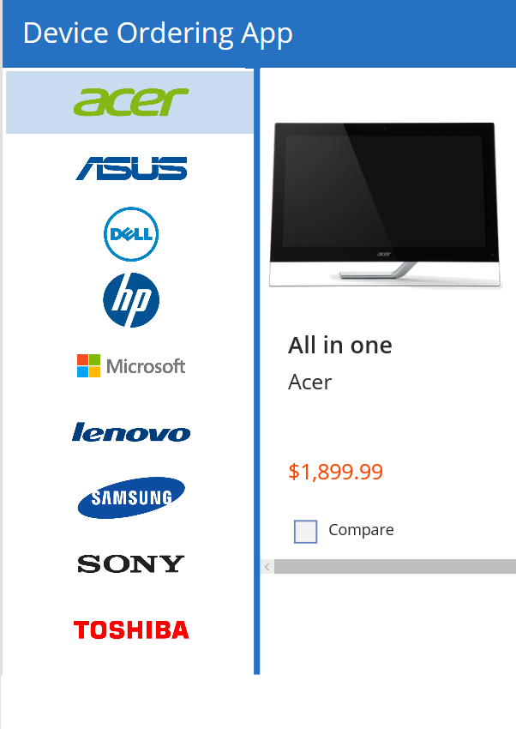
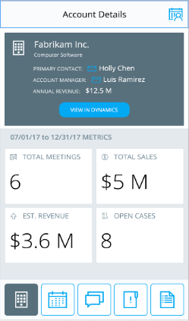

Power Apps: a low-code approach to build mobile apps, desktop apps and web portals
Easily build web & mobile apps with a full featured low-code / no-code platform.
Combine PowerPoint with Excel = Power Apps!
Add mixed reality experiences to your apps
Connect to your existing data with 450+ pre-built connectors and custom connectors
Leverage device features such as camera, GPS, microphone and pen & ink with no code!
Business users solve business problems. Partnering with Pro-dev’s to extend and integrate. No limits.
Integrates with Microsoft Teams, Office 365, Azure, Dynamics, Power Automate & Power BI
Strong enterprise governance & security

Slide 9
Unlock more with Microsoft Power Apps Power Apps combines a simple visual approach with advanced tools, making it easier for everyone to build better apps more efficiently
Get to better solutions faster
Enable employees to build and launch their own apps to address their own business challenges – with nothing to slow them down
Make better use of resources
Free up limited pro dev resources and enable them to work faster on mission critical apps and enterprise wide solutions
Optimize existing investments
Build apps that integrate seamlessly with your Office 365, Dynamics 365 and Azure tools and data
Drive business value and increase ROI

Slide 10
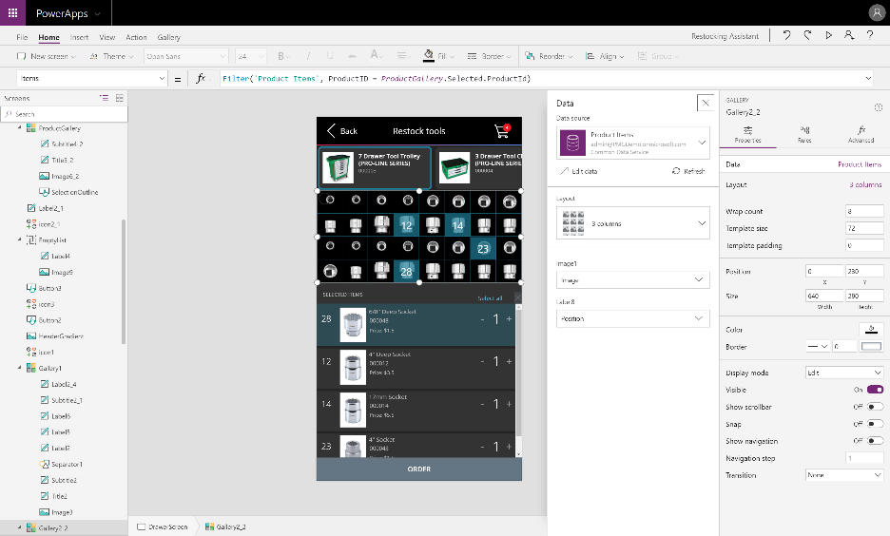
Power Apps Studio
Authoring experience for creating Power Apps
7
Always updated with the latest builds and allows you to work in your browser
4
6
5
1
Left navigation bar
Middle pane
Right-hand pane
Properties
Formular bar
Ribbon
Additional items
2
3
Notes:
If all of them don’t fit to your needs, configure it further with the Canvas apps authoring experience
Start with your data
Start with a blank canvas
Start with a template

Slide 11
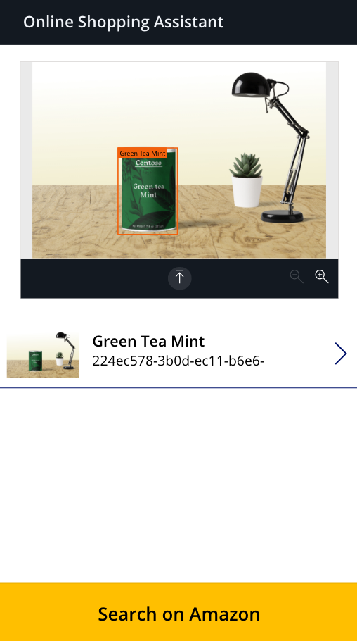
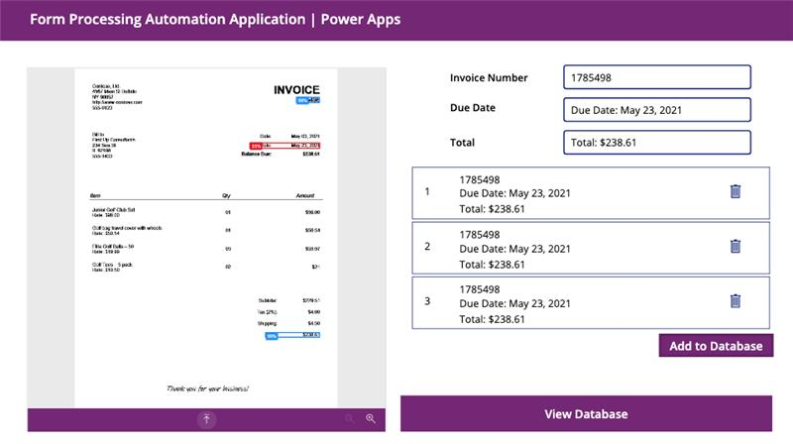
Hands-on Workshop Overview
End Product Showcase
Online Shopping Assistant
Object Detection AI model
Form Processing Automation Application
Form Processor Model / Optical Character Recognition (OCR)
Notes:
Now as we approach the end of the sharing, I’d like to do a quick demo on the end-state of what can be achieved by completing the training manual.
I will end off with a quick demonstration of the end product of what we can expect from a student from completing this training manual.

Slide 12
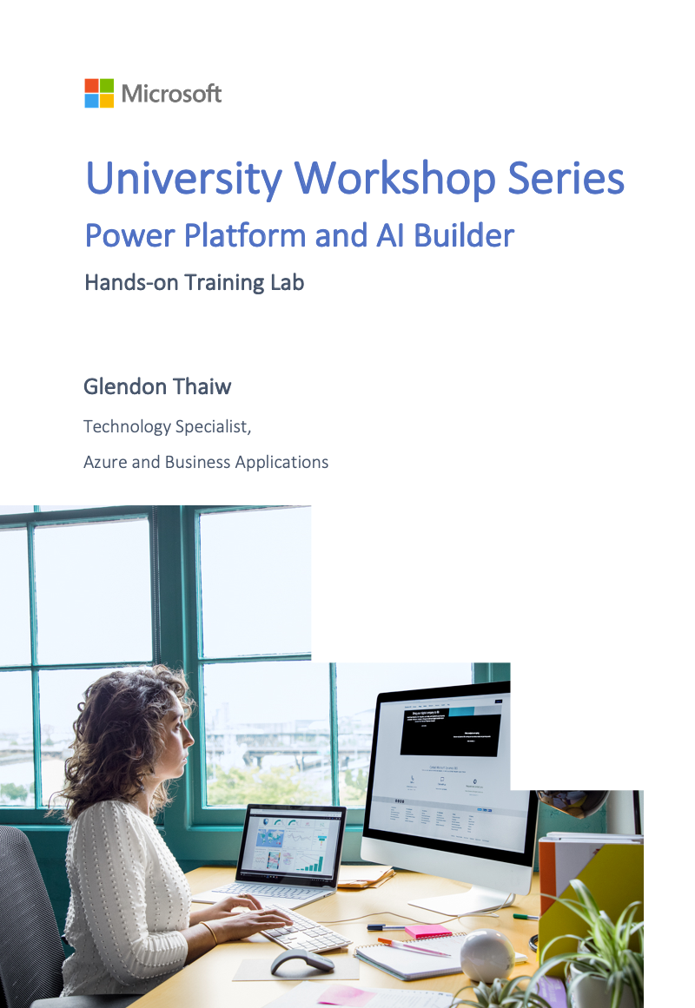
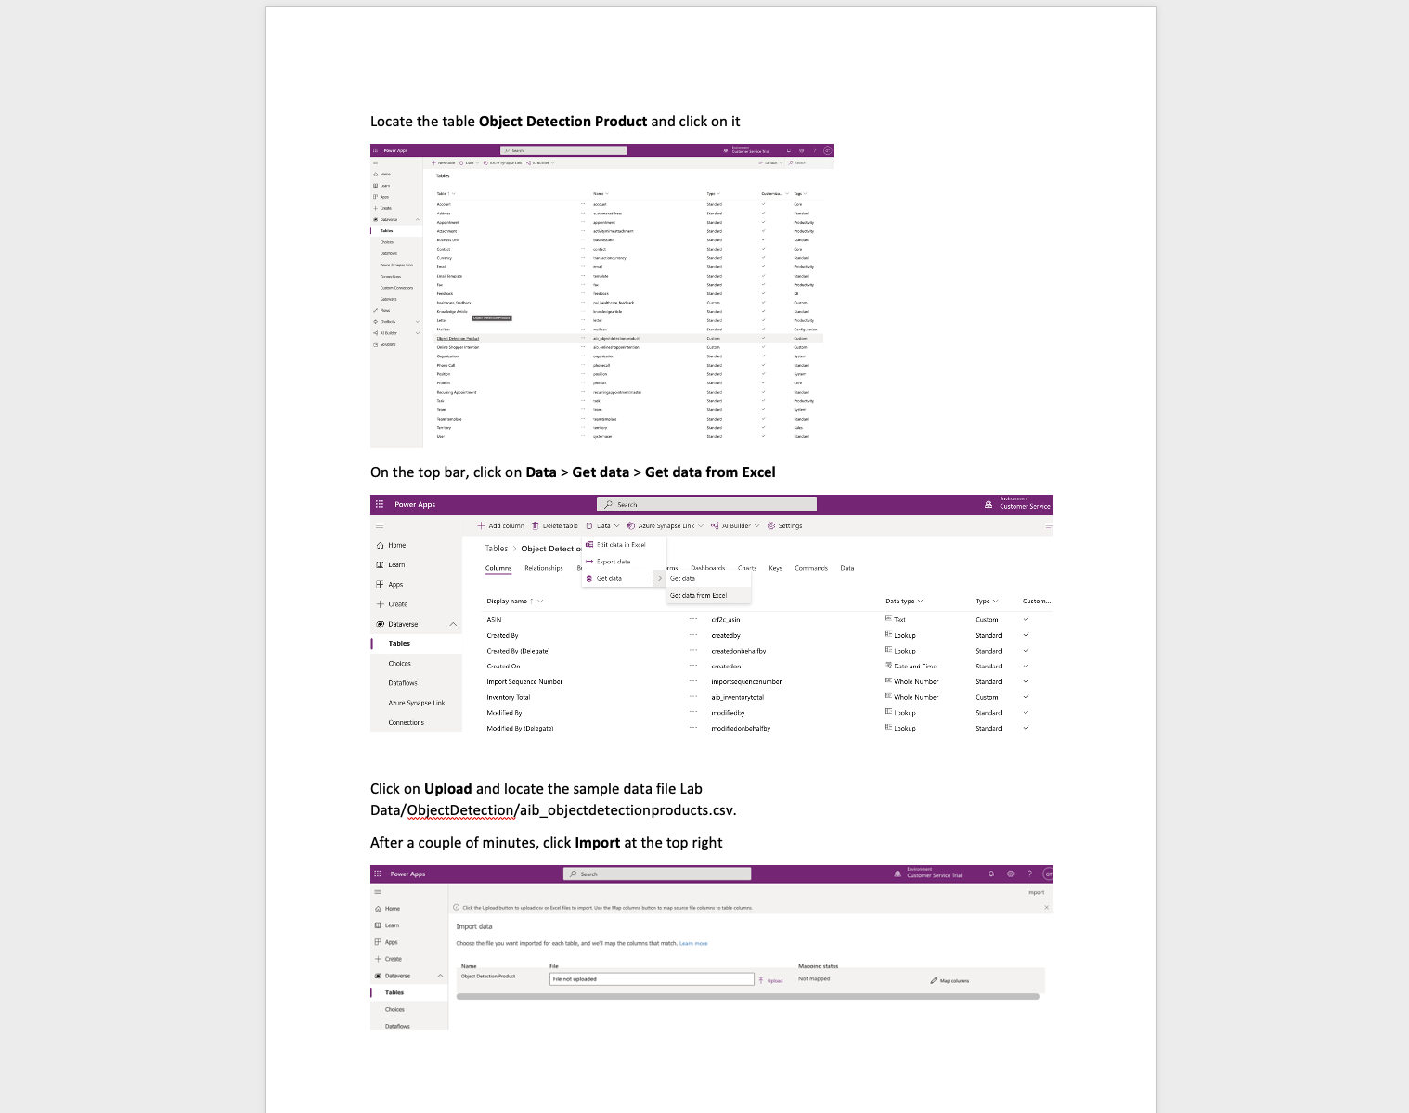
Workshop Resources
Hands-on Training Lab Overview
Notes:
D365 Omnichannel for Customer Service Hands-on Training Lab Overview
Now that we understand Dynamics 365 Omnichannel for Customer Service, let us discuss how we can bring this into the classroom by utilizing a training manual built for the solution.
This training manual has been created by one of our supporting architects at Microsoft – and it encompasses an end-to-end learning journey to start operating with the platform. Taking the form of a word document, it contains step-by-step instructions to get an environment up and running.

Slide 13
Questions and Answers

